Slide 1
THE NATURE OF MATTER
(CLASSIFICATION OF MATTER)

Slide 2
CLASSIFICATION OF MATTER
EARLIER SCIENTISTS
MODERN SCIENTISTS
MATTER
MATTER
AIR
WATER
BASIS OF ITS PHYSICAL STATE
BASIS OF ITS CHEMICAL
CONSTITUTION
EARTH
SKY
FIRE

Slide 3
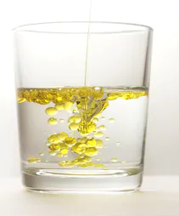
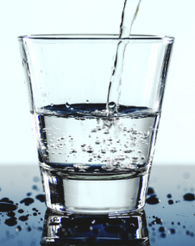
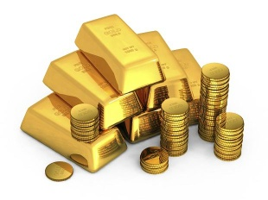
CHEMICAL CONSTITUTION
PURE SUBSTANCES
MIXTURES
1) CONSTANT COMPOSITION
1) VARIABLE COMPOSITION
2) HOMOGENEOUS–UNIFORM COMPOSITION THROUGHOUT
2) HOMOGENEOUS/
HETEROGENEOUS–VARIED
COMPOSITION
Example – Gold
Pure water
Example – Oil + Water

Slide 4
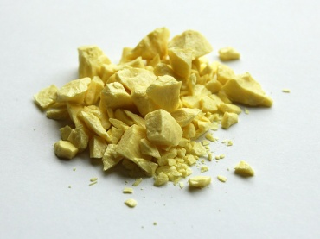
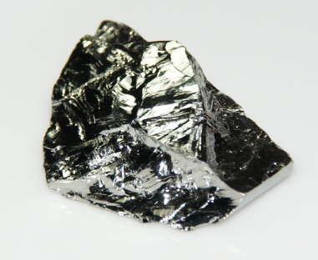
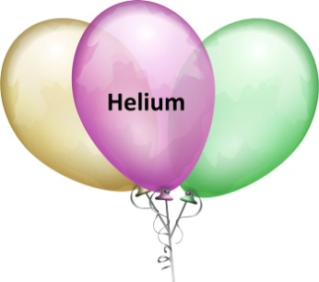
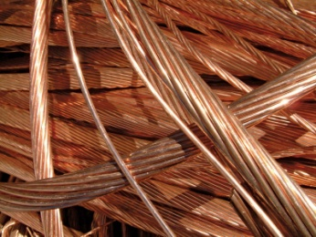
PURE SUBSTANCES
Elements
Compounds
Metals
(Iron, Copper,
Gold)
Non-Metals
(Nitrogen, Oxygen,
Sulphur)
Metalloid
(Arsenic, Germanium,
Antimony)
Inert Gases
(Helium, Neon, Argon)
COPPER
SULPHUR
GERMENIUM
HELIUM

Slide 5
ELEMENTS
A PURE SUBSTANCE WHICH CANNOT BE BROKEN DOWN INTO TWO OR MORE SIMPLER PURE SUBSTANCES BY ANY CHEMICAL MEANS IS CALLED AN ELEMENT.
Natural
There are 118 elements
Man-made
Radioactive

Slide 6
METALS
1
GENERALLY SOLIDS
2
GENERALLY MALLEABLE AND DUCTILE
3
GOOD CONDUCTOR OF HEAT AND ELECTRICITY
4
POSSESS LUSTRE, HARD, SONOROUS
5
USUALLY FOUND IN COMBINED STATE
6
ELECTRO-POSITIVE ELEMENTS

Slide 7
NON-METALS
1
CAN EXIST IN ALL THE THREE STATES
2
NON-MALLEABLE OR DUCTILE
3
BAD CONDUCTOR OF HEAT AND ELECTRICITY
4
DO NOT POSSESS LUSTRE, NOT SONOROUS
5
ELECTRO-NEGATIVE ELEMENTS

Slide 8
METALLOID
PROPERTIES ARE INTERMEDIATE BETWEEN METALS AND NON-METALS
Eg. Arsenic, Antimony, Germanium, Bismuth
NOBLE GASES
KNOWN AS RARE GASES AS THEY ARE FOUND IN TRACE AMOUNTS
1
EXTREMELY STABLE
DO NOT INTERACT WITH OTHER GASES - INERT
2

Slide 9
SYMBOLS
THE SHORT FORMS TO WRITE THE NAMES OF ELEMENTS IS TAKEN TO BE SYMBOLS
HOW TO REPRESENT SYMBOLS
J. J BERZELIUS INTRODUCED THE MODERN SYSTEM OF NAMING ELEMENTS.
USUALLY EACH ELEMENT IS DENOTED BY THE FIRST LETTER OF ITS NAME
Eg. Carbon – C
Oxygen – O
Hydrogen - H
1

Slide 10
SYMBOLS (contd..)
SOME ELEMENTS WERE NAMED ON THE BASIS OF THEIR FIRST TWO LETTERS, WHEN THE FIRST LETTER WAS ALREADY CHOSEN.
Eg. Cobalt – Co
Calcium – Ca
2
IF MORE THAN TWO ELEMENTS EXIST WHOSE NAMES START FROM THE SAME ALPHABET THEN THE SYMBOLS ARE DERIVED FROM LATIN NAMES
Eg. Gold – Aurum - Au
Sodium – Natrium - Na
3

Slide 11
SYMBOLS OF SOME ELEMENTS ARE
METALS
NON-METALS
Name
Symbol
Name
Symbol
Magnesium | Mg
Platinum | Pt
Iron (Ferrum) | Fe
Nickel | Ni
Silver | Ag
Nitrogen | N
Fluorine | F
Iodine | I
Chlorine | Cl
METALLOIDS
NOBLE GASES
Name
Symbol
Name
Symbol
Antimony | Sb
Arsenic | As
Bismuth | Bi
Germanium | Ge
Helium | He
Krypton | Kr
Neon | Ne

Slide 12
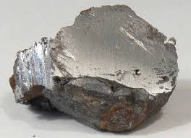
FORMATION OF A COMPOUND
Ferrous Sulphide (FeS) from its elements Fe and S
Properties
Fe - It is a metallic element attracted by a magnet
S – It is a non-metal, yellow in colour, soluble in carbon disulphide
IRON
SULPHUR

Slide 13
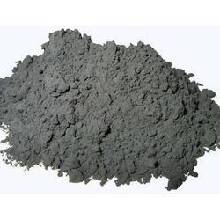
FORMATION OF FERROUS SULPHIDE
Ferrous Sulphide (FeS) from its elements Fe and S
Fe and S are chemically combined (heated) to form a new compound (FeS)
Properties
FeS is not attracted by a magnet
It does not dissolve in carbon disulphide.
FERROUS SULPHIDE
SO, A COMPOUND HAS ENTIRELY DIFFERENT SET OF PROPERTIES THAN ITS CONSTITUENT ELEMENTS

Slide 14
CHARACTERISTICS OF COMPOUNDS
1
PURE SUBSTANCES
FORMED BY COMBINATION OF TWO OR MORE ELEMENTS IN A FIXED RATIO BY MASS
2
PROPERTIES OF A COMPOUND ARE ENTIRELY DIFFERENT FROM THOSE OF ITS CONSTITUENT ELEMENTS
3
4
HOMOGENEOUS SUBSTANCE
DEFINITE MELTING POINT, BOILING POINT, CHEMICAL AND PHYSICAL PROPERTIES
5

Slide 15
THE DIFFERENCES BETWEEN COMPOUNDS AND MIXTURES
COMPOUNDS | MIXTURES
1. A new substance is produced when the compound is formed | 1. No new substance is produced when the mixture forms
2. It contains one substance only. | 2. It contains two or more substances.
3. The properties of compounds are different from the elements in them | 3. The properties of mixtures are similar to the substance present in them
4. The elements in compounds can only be separated by chemical reaction | 4. The substance in mixtures can often be separated easily
5. Compounds have definite composition | 5. Mixtures have variable composition

Slide 16
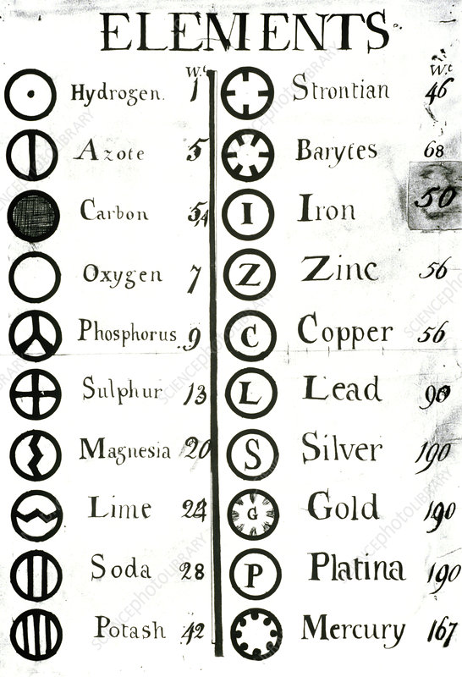
AN INTERESTING FACT
Earlier, the known elements were not denoted by letters. John Dalton, a famous chemist made a list of substances which he thought were elements. And he gave symbols to these elements in his own way.

Slide 17
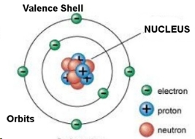
STRUCTURE OF ATOM
Electropositive elements (metals) → 1,2,3 electrons in valence shells → donates electrons
Electronegative elements (non-metals) → 4,5,6,7 electrons in valence shells → accepts electrons

